Slide 1
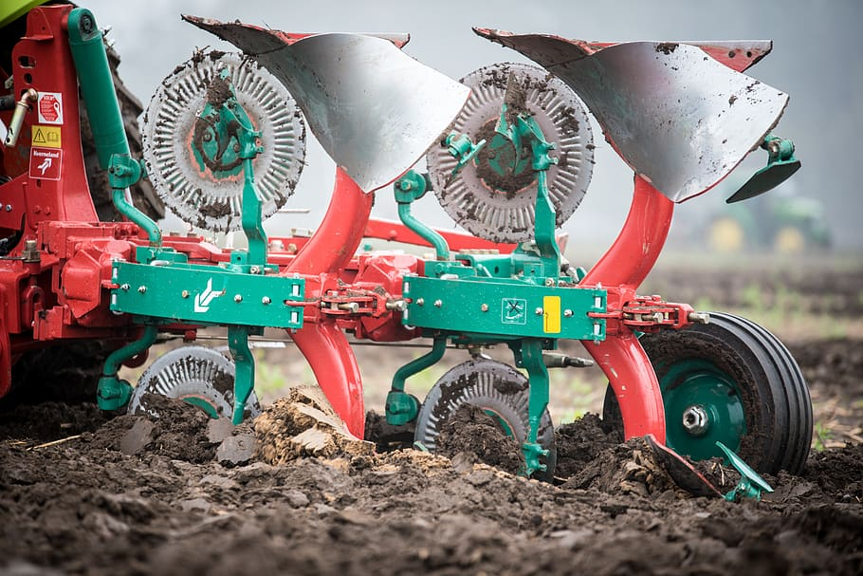
WELCOME

Slide 2
TILLAGE
SUBMITTED BY
Name –………
Roll No-…….
H.O.D
Name …….
LECTURER
Name ……..

Slide 3
INTRODUCTION
Tillage is the first and the most important operation in crop production.
Tillage operations are generally carried out before sowing or
planting.
Although a very large area of land is available in the world, all of
it is not fit for crop production.
In order to bring to bring these these areas into an economically
fit condition, variety of mechanical operations have
to be performed.

Slide 4
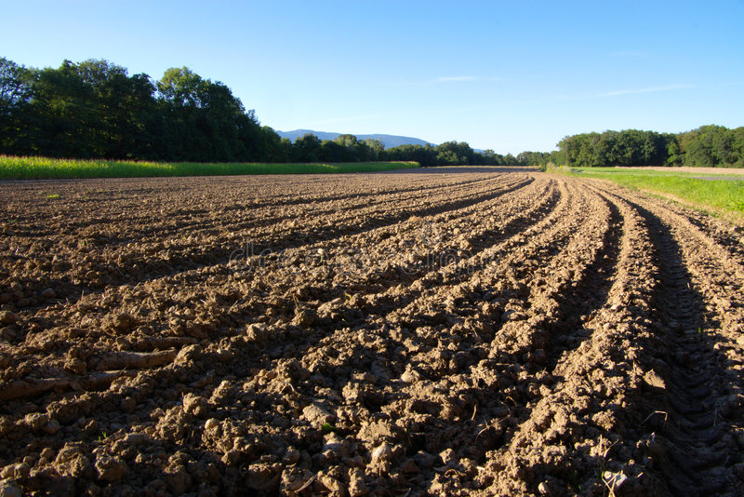
TILLAGE
Tillage is the mechanical manipulation of soil to provide favourable condition for crop production.

Slide 5
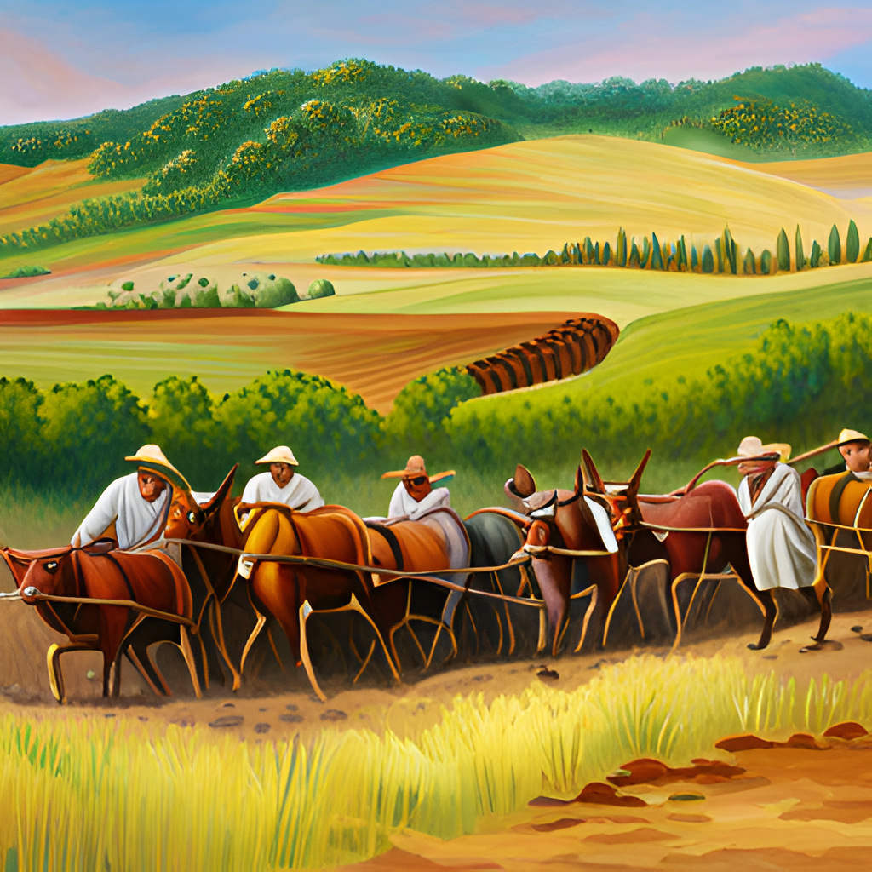
HISTORY OF TILLAGE
The Origins of Tillage
Tillage is a practice that has been used by humans for thousands of years. The earliest evidence of tillage dates back to around 5000 BCE in ancient Mesopotamia, where farmers used primitive plows to prepare their fields for planting.
Over time, the practice of tillage spread throughout the world as agriculture became more widespread. In Europe, the Romans were known for their advanced tillage techniques, which included the use of iron plows and animal power.

Slide 6
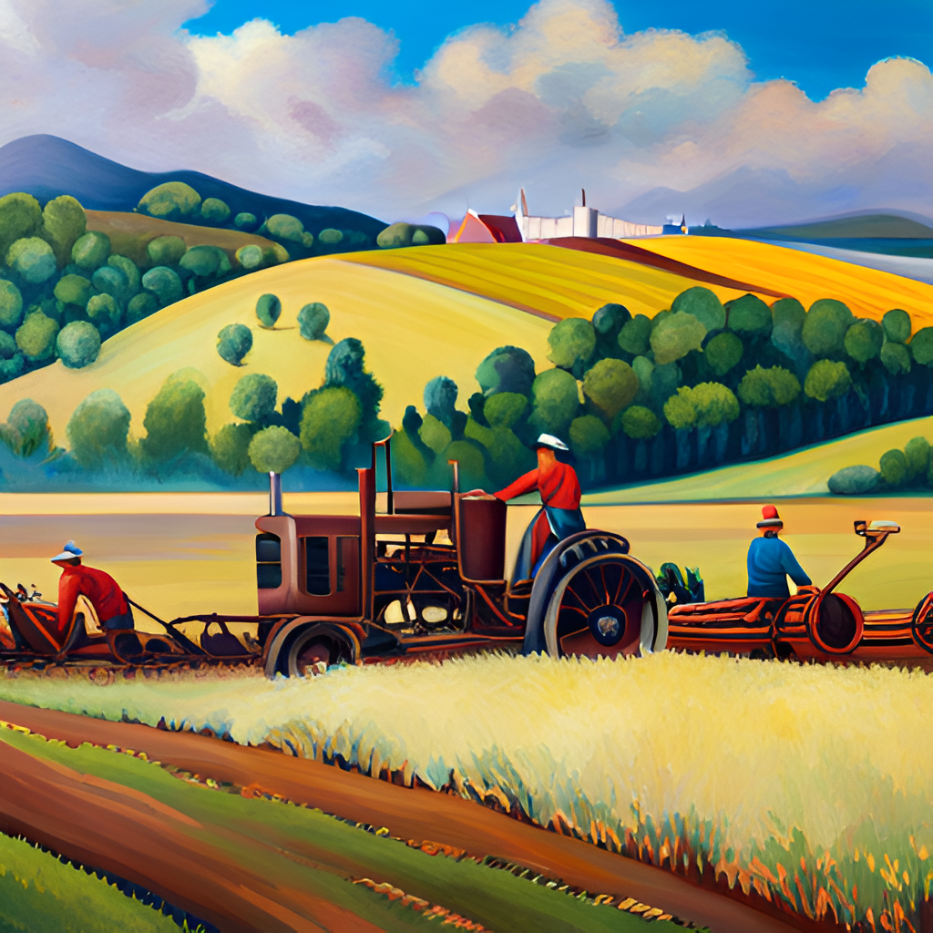
The Industrial Revolution and Tillage
The Industrial Revolution brought significant changes to tillage practices. With the invention of new farm machinery like the steam-powered tractor and the mechanical reaper, farmers were able to till larger fields and harvest crops more efficiently than ever before.
However, these advances also led to concerns about soil erosion and depletion, as well as the displacement of small farmers who could not afford the expensive new equipment.

Slide 7
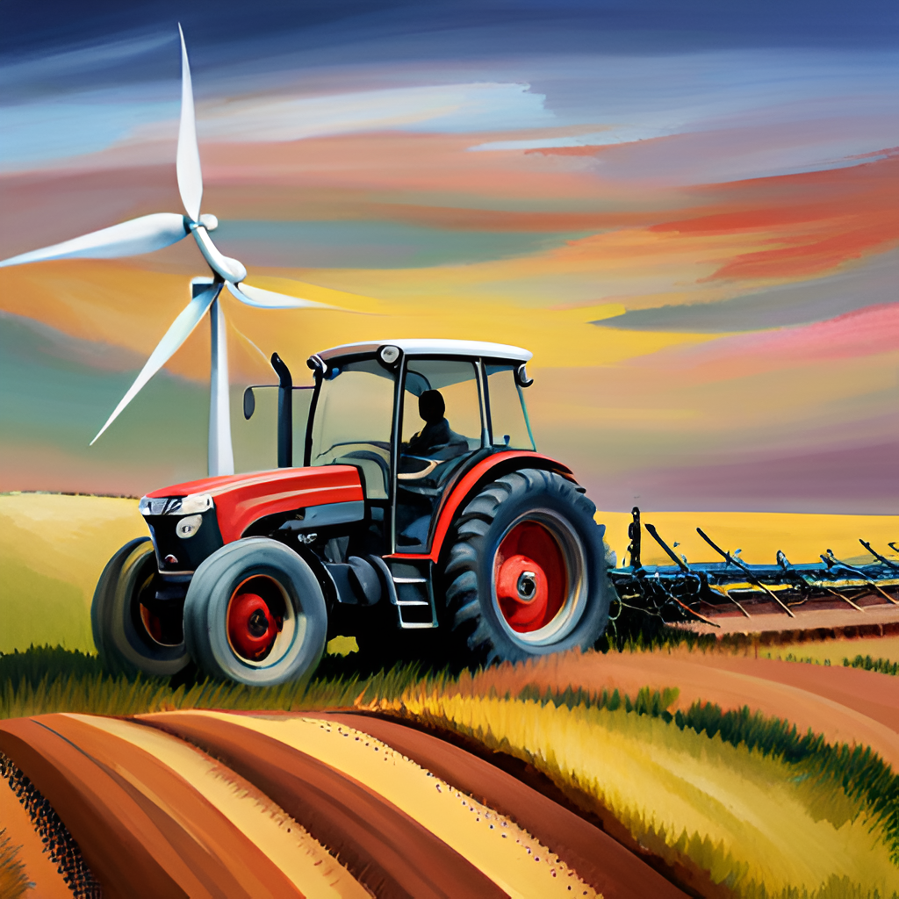
Modern Tillage Techniques
Today, tillage practices continue to evolve as farmers seek to balance productivity with sustainability. Conservation tillage methods like no-till and reduced tillage have become increasingly popular, as they help to reduce soil erosion and improve soil health.
At the same time, new technologies like precision farming and GPS-guided tractors are allowing farmers to till their fields more precisely and efficiently than ever before.

Slide 8


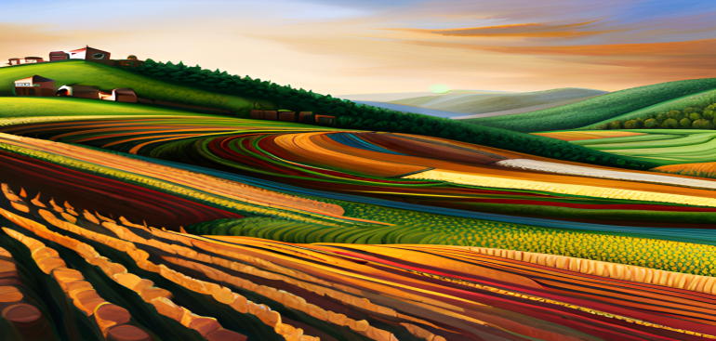
OBJECTIVES OF TILLAGE
Suitable seed bed preparation
Weed control
Soil and water conservation
Improvement of soil structure
Soil permeability
Soil aeration
Root penetration
Destruction of pests

Slide 9
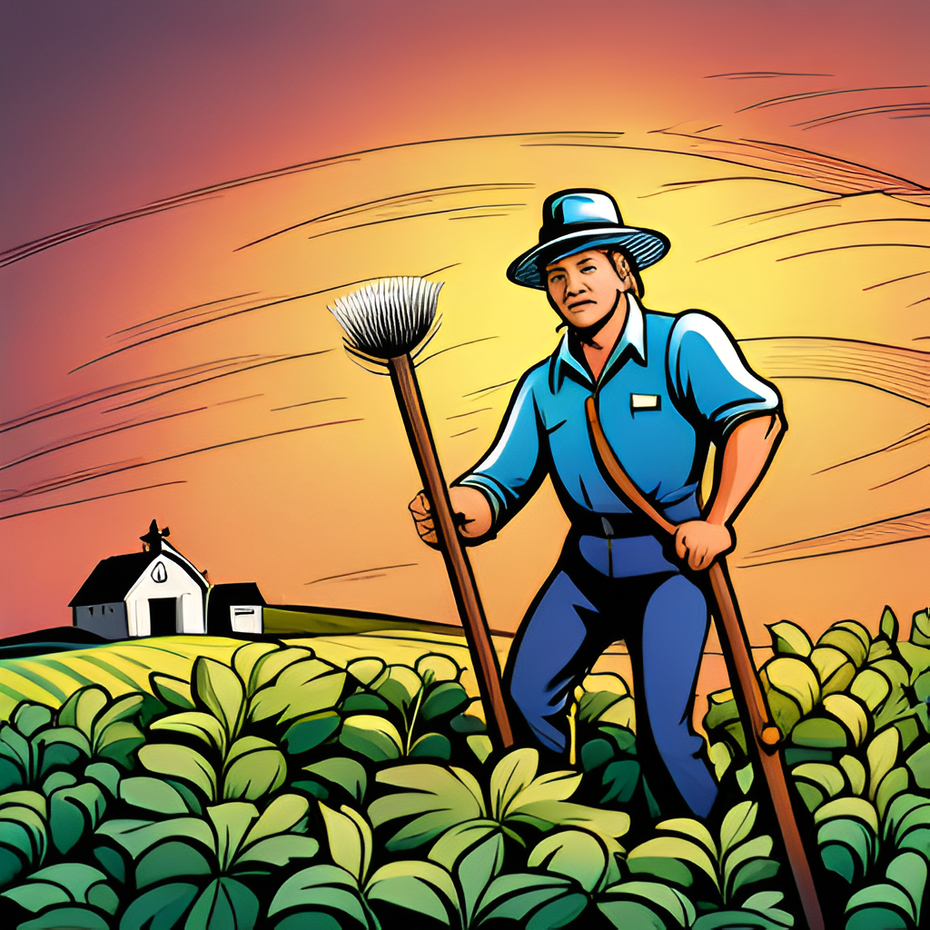
Advantages of Tillage
One advantage of tillage is that it can help control weeds. By breaking up the soil, tillage can expose weed roots to the air and dry them out, making it harder for them to grow.
Tillage can also help improve soil structure and fertility. Breaking up the soil allows air and water to penetrate deeper, which can help plant roots grow stronger and healthier.

Slide 10
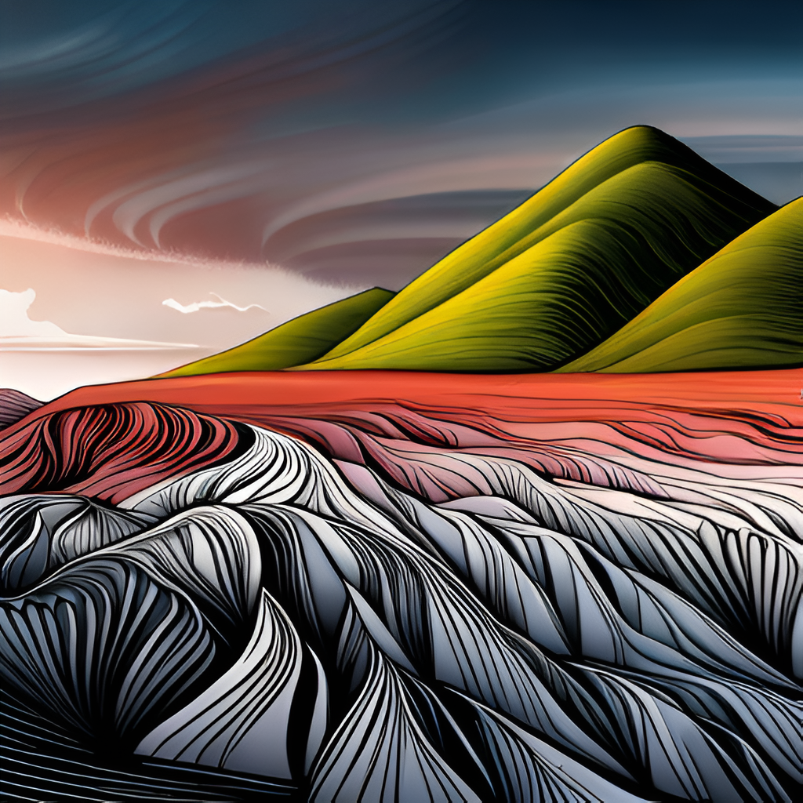
Disadvantages of Tillage
One disadvantage of tillage is that it can lead to soil erosion. When the soil is broken up, it becomes more vulnerable to wind and water erosion, which can wash away valuable topsoil.
Tillage can also disrupt the natural balance of soil microorganisms. These microorganisms play an important role in breaking down organic matter and releasing nutrients into the soil. Excessive tillage can destroy these microorganisms and reduce soil fertility.

Slide 11
TYPES OF TILLAGE
PREPARATORY CULTIVATION
AFTER CULTIVATION
PRIMARY TILLAGE
SECONDARY TILLAGE
LAYOUT OF SEEDBED
DEEP TILLAGE
SUB SOILING
YEAR ROUND TILLAGE

Slide 12
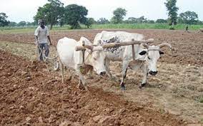
PRIMARY TILLAGE
Primary tillage is the first soil tillage after the last harvest. It is normally conducted when the soil is wet enough to allow plowing and strong enough to give reasonable levels of traction.
OBJECTIVES OF PRIMARY TILLAGE
To reduce soil strength
To rearrange aggregates
To cover plant materials and burry weeds
To kill insects and pests

Slide 13
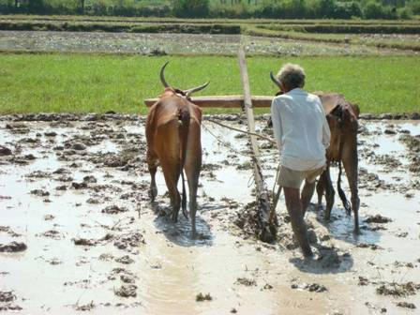
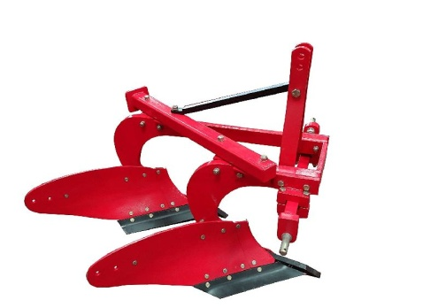
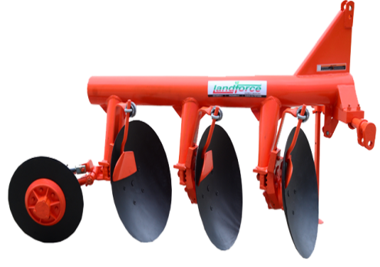
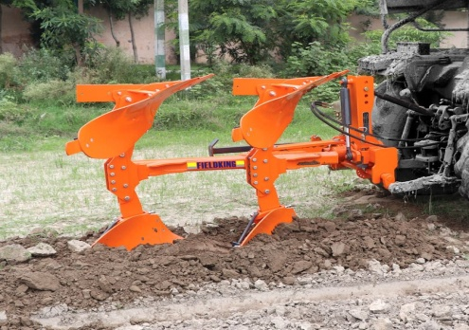
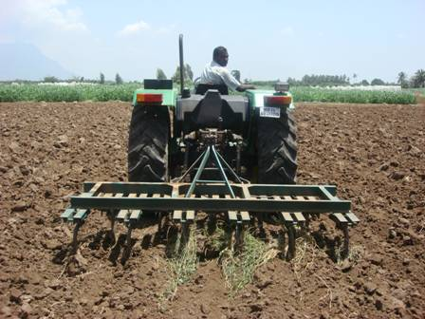
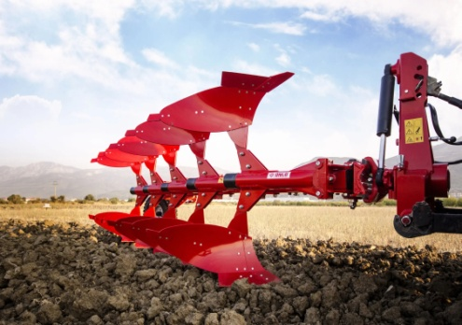

PRIMARY TILLAGE IMPLEMENTS
✓ Wooden plough Soil Turning Ploughs
✓Mouldboard Plough
✓ Disc Plough
✓ Turn-wrest or Reversible or One-way Plough
✓ Subsoil Plough
✓Chisel Plough
✓ Rotary Plough

Slide 14
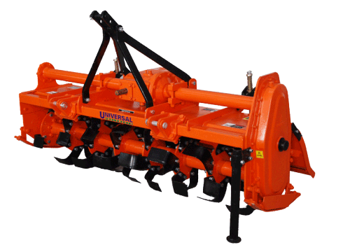
SECONDARY TILLAGE
Secondary tillage consists of conditioning the soil to meet the different tillage objectives of the farm. These operations consume less power per unit area compared to primary tillage operations.
OBJECTIVES OF SECONDARY
Tillage Improve soil tilt and prepare a seedbed.
Manipulate plant residues and farm wastes.
Manage water and air in the soil Control weeds and soil-borne insects pests and diseases.
Establish a surface layer which prevents wind and soil erosion

Slide 15
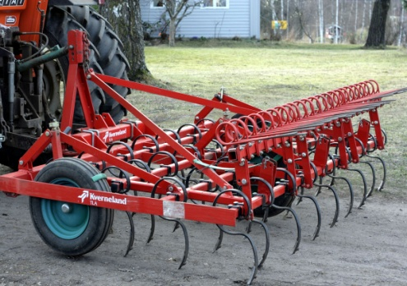
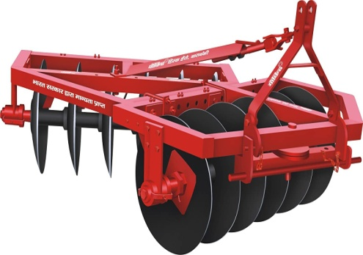
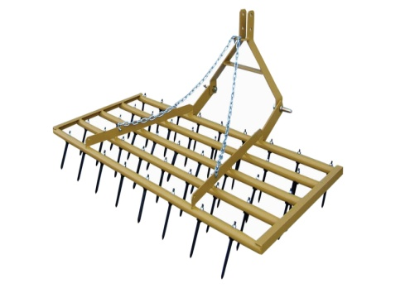
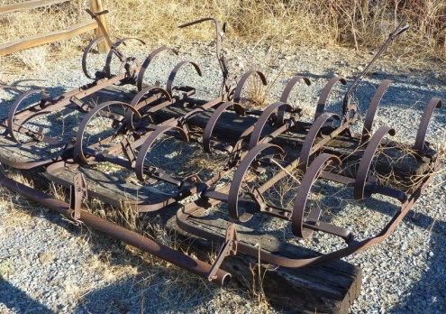
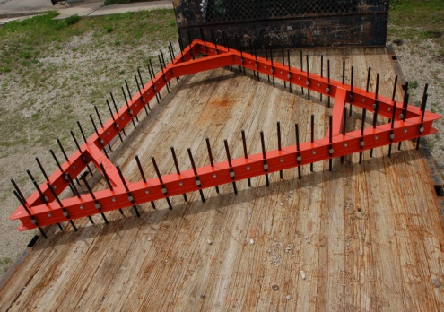
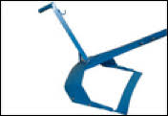
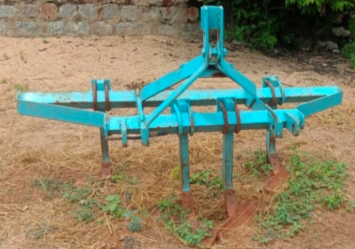
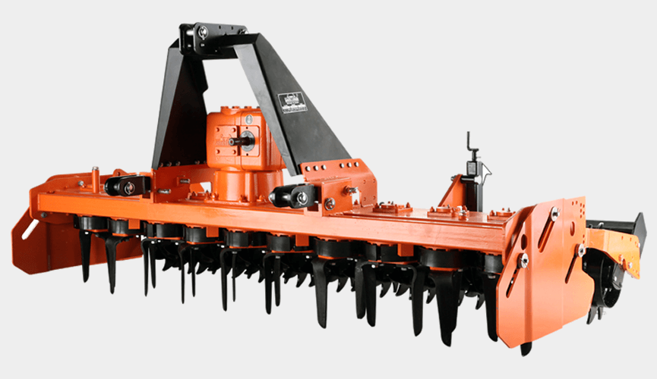
SECONDARY TILLAGE IMPLEMENTS
Harrow
Disc harrow
Spike tooth harrow
Spring tooth harrow
Triangular harrow
Blade harrow (Bakhar)
Guntaka
Reciprocating power harrow
Acme harrow
Patela

Slide 16
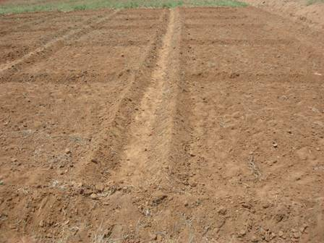
LAYOUT OF SEEDBED
After the seedbed preparation, the field is laid out properly for irrigation and sowing or planting seedlings.
These operations are crop specific. For most of the crops like wheat, soybean, pearl millet, groundnut, castor etc.
fIat levelled seedbed is prepared.

Slide 17
THE EFFECT OF TILLAGE ON SOIL
CHOOSING FREQUENT TILLAGE WITHIN A SEASON
Every growing season is different and the best managers make decisions based on frequent scouting and our knowledge of soil conservation practices.
FREQUENT TILLAGE OVER A COUPLE SEASONS:-
When producers use unnecessary tillage, more serious problems begin to occur. Without a break from tillage, a total break down of soil structure is possible. Soil organisms can be affected, bringing microbial activity to a halt. Soil pores are closed, imposing severe limitations on infiltration and increasing runoff
FREQUENT TILLAGE AND WATER QUALITY:-
Frequent tillage can also contribute to deterioration in overall surface water quality. Sediment from soil erosion is a major water quality pollutant. Sediment also transports nitrogen and phosphorus from fields into lakes and streams, leading to 'eutrophication’.
FREQUENT TILLAGE -- COSTLY IN MANY WAYS:-
Frequent tillage can be costly in terms of soil quality, soil productivity and surface water quality as well as extra wear on machinery and extra labor requirements. Before making choices about tillage, producers should consider the impact of sustained frequent tillage on soil quality.

Slide 18
MODERN CONCEPT OF TILLAGE:-
In conventional tillage the soil is opened with a mould board plough for primary tillage. The soil mass is broken into a loose system of clods of mixed sizes. Subsequently a fine seed bed is prepared by secondary tillage in which operations like crushing of clods, repacking, incorporation of plant residues, fertilizers, smoothing of soil surface etc. is done.
This process involves wastage of energy and destruction of soil structure. To cut down cost of tillage researches were done to know whether several tillage operation are needed or not. The concept of minimum tillage was conceived in USA as repeated use of machinery resulted is destroying soil structure, causing soil pans and also soil erosion. The important aspect of tillage is weed control and this can be achieved by using herbicides.
The practice of inverting the top soil in order to bury the crop residues is less important object of tillage in modern field management. Crop residues can and in many cases be left over as stubble mulch to protect against soil erosion and evaporation loss. Researchers have shown that frequent tillage is often rarely beneficial and in fact detrimental. All these reasons led to the development and practice of minimum tillage, zero tillage and stubble mulch farming.

Slide 19
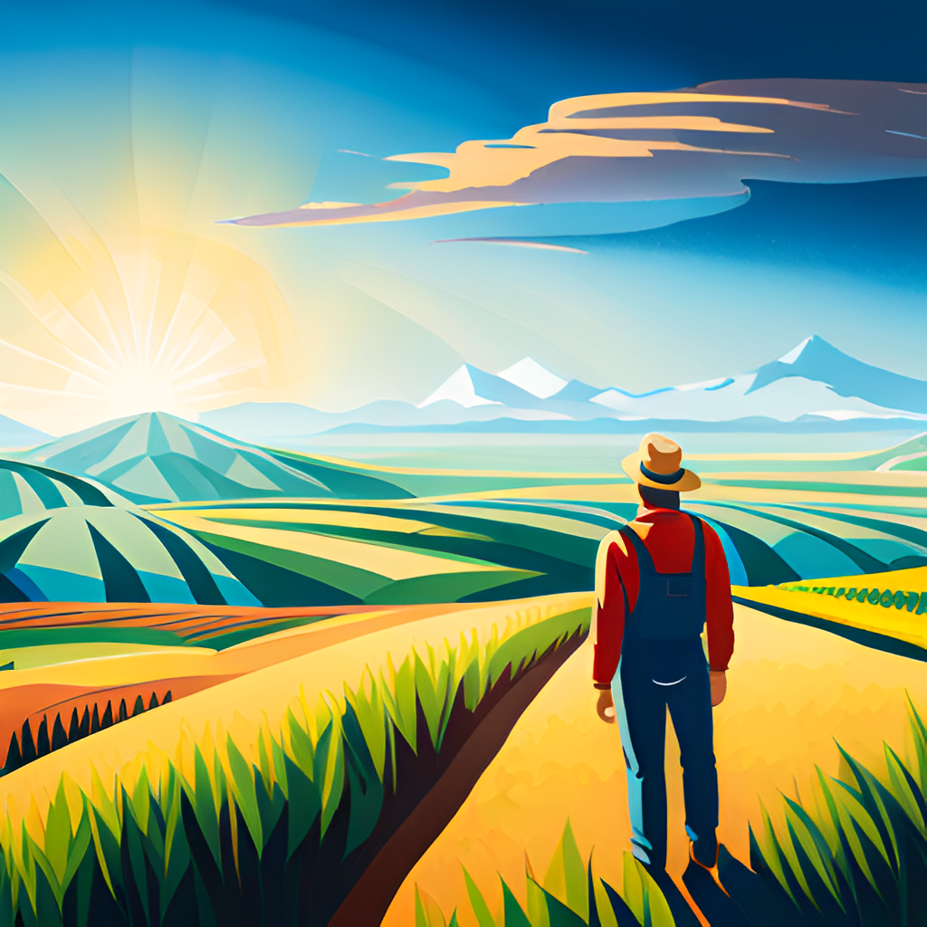
Conclusion
Tillage is a key agricultural practice that has both benefits and drawbacks. While conventional tillage has been the norm for many years, alternative tillage practices are gaining popularity due to their potential to improve soil health and reduce environmental impacts.
Ultimately, the choice of tillage method will depend on factors such as soil type, climate, crop type, and farm management goals. By carefully considering these factors, farmers can make informed decisions about tillage practices that will benefit both their crops and the environment.

Slide 20
THANK YOU SIR

